Slide 1
Objectives
In this session, you will learn to:
  Understand F11:Features
  Understand F12: Configurations
  Set up account heads
Notes:
Share the session objectives with the students.

Slide 2
Understanding F11: Features
The F11: Features:
  Are company-specific.
  Are divided into the following categories:
    Accounting features
    Inventory features
    Statutory & taxation
    Tally.NET features
Notes:
Share the session objectives with the students.

Slide 3

Understanding F11: Features (Contd.)
Where are these categories of F11: Features available and how can we view these categories?
Notes:
Share the session objectives with the students.

Slide 4

Understanding F11: Features (Contd.)
The F11: Features categories are available in Company Features menu. To view the Company Features menu, you need to perform the following task:
Go to Gateway of Tally > press F11: Features
Notes:
Share the session objectives with the students.

Slide 5
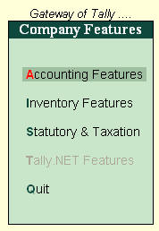
Understanding F11: Features (Contd.)
The following figure shows the Company Features menu.
Notes:
Share the session objectives with the students.

Slide 6
Understanding F11: Features (Contd.)
F1: Accounting Features:
  The Accounting features:
    Consists of configurations/functionalities, which generally affects Accounting transactions and reports.
    Is further sub-divided into the following sections:
      General
      Outstanding Management
      Cost/Profit Centres Management
      Invoicing
      Budgets/Scenario Management
      Other Features
Notes:
Share the session objectives with the students.

Slide 7
Understanding F11: Features (Contd.)
How can we view the Accounting Features screen?
Notes:
Share the session objectives with the students.

Slide 8
Understanding F11: Features (Contd.)
To view the accounting feature screen, you need to perform the following task: Go to Gateway of Tally > F11: Features > Accounting Features
or
Go to Gateway of Tally > F11: Features > click on F1: Accounts
Notes:
Share the session objectives with the students.

Slide 9
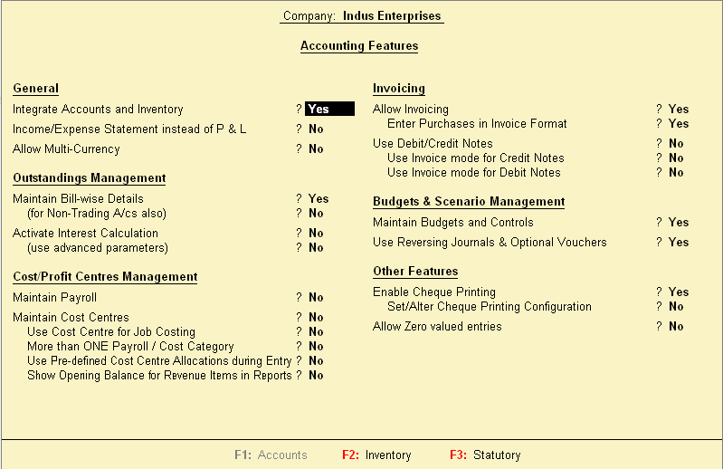
Understanding F11: Features (Contd.)
The following figure shows Accounting Features screen.
Notes:
Share the session objectives with the students.

Slide 10
Understanding F11: Features (Contd.)
F2: Inventory Features:
  The Inventory features:
    Comprises of configurations or functionalities pertaining to Inventory transactions and reports.
    Is further sub-divided into the following sections:
      General
      Storage and Classification
      Order Processing
      Invoicing
      Purchase Management
      Sales Management
      Additional Inventory Vouchers
      Payroll
Notes:
Share the session objectives with the students.

Slide 11
Understanding F11: Features (Contd.)
How can we view the Inventory Features screen?
Notes:
Share the session objectives with the students.

Slide 12
Understanding F11: Features (Contd.)
To view the inventory feature screen, you need to perform the following task:
Go to Gateway of Tally > F11: Features > Inventory Features
or
Go to Gateway of Tally > F11: Features > click on F2: Inventory
Notes:
Share the session objectives with the students.

Slide 13
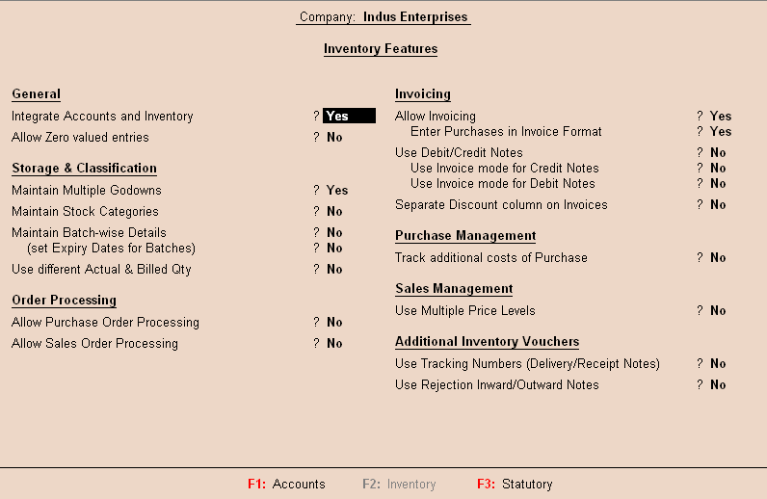
Understanding F11: Features (Contd.)
The following figure shows Inventory Features screen.
Notes:
Share the session objectives with the students.

Slide 14
Understanding F11: Features (Contd.)
F3: Statutory & Taxation:
  The Statutory & Taxation features:
    Comprises of configurations/functionalities pertaining to statutory compliances available in Tally.ERP 9.
    Is country specific and strictly depends upon the Country selected in the Company Creation screen.
  The following features are available, when India is selected in the Statutory Compliance for field in the Company Creation screen:
    Excise
    Value Added Tax
    Service Tax
    Tax Deducted at Source
    Tax Collected at Source
    Fringe Benefits
Notes:
Share the session objectives with the students.

Slide 15
Understanding F11: Features (Contd.)
How can we view the Statutory & Taxation features screen?
Notes:
Share the session objectives with the students.

Slide 16
Understanding F11: Features (Contd.)
To view the statutory & taxation screen, you need to perform the following task:
Go to Gateway of Tally > F11: Features > Statutory & Taxation
or
Go to Gateway of Tally > F11: Features > click on F3: Statutory
Notes:
Share the session objectives with the students.

Slide 17
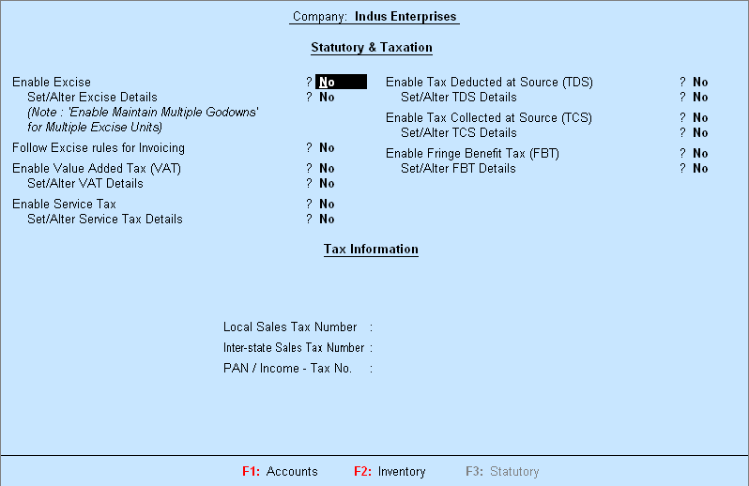
Understanding F11: Features (Contd.)
The following figure shows Statutory & Taxation screen.
Notes:
Share the session objectives with the students.

Slide 18
Understanding F11: Features (Contd.)
F4: Tally.NET Features:
  The Tally.NET Features screen comprises of Registration and Remote Access of company data on Tally.NET.
Notes:
Share the session objectives with the students.

Slide 19
Understanding F11: Features (Contd.)
How can you view the Tally.NET Features screen?
Notes:
Share the session objectives with the students.

Slide 20
Understanding F11: Features (Contd.)
The Tally.NET features screen will be available only when, the Use Security Control option is set to Yes in the Company Master.
Notes:
Share the session objectives with the students.

Slide 21
Understanding F12: Configurations
F12: Configurations:
  Are provided for Accounting, Inventory and printing options.
  Are user-definable as per user requirements.
  Are applicable to all the companies residing in the Tally.ERP 9 data directory.
Notes:
Share the session objectives with the students.

Slide 22
Understanding F12: Configurations (Contd.)
How can we view the Configuration menu?
Notes:
Share the session objectives with the students.

Slide 23
Understanding F12: Configurations (Contd.)
To view the Configuration menu, you need to perform the following task:
Go to Gateway of Tally > press F12: Configure
Notes:
Share the session objectives with the students.

Slide 24
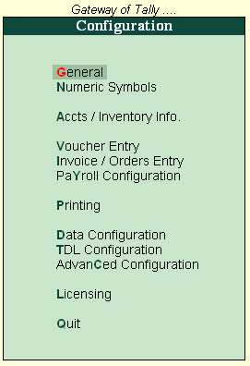
Understanding F12: Configurations (Contd.)
The following figure shows the Configuration menu.
Notes:
Share the session objectives with the students.

Slide 25
Understanding F12: Configurations (Contd.)
What kind of information can be configured in General configuration
screen?
Notes:
Share the session objectives with the students.

Slide 26
Understanding F12: Configurations (Contd.)
It allows you to configure
Country Details, Style of Names, Dates and Numbers.
Notes:
Share the session objectives with the students.

Slide 27
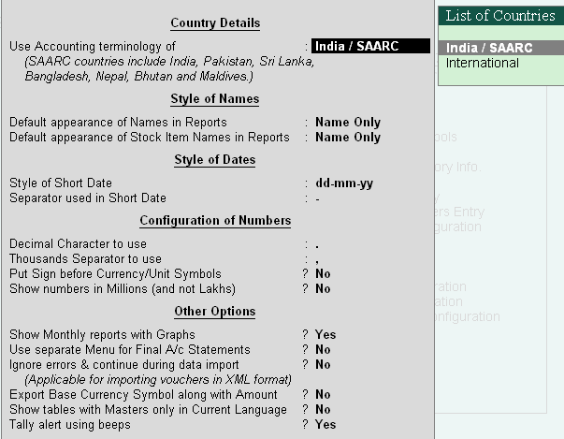
Understanding F12: Configurations (Contd.)
General:
  The following figure shows General configuration screen.
Notes:
Share the session objectives with the students.

Slide 28
Understanding F12: Configurations (Contd.)
Numeric Symbols:
  You can configure Number Styles and Symbols used to represent:
    Positive numbers
    Negative numbers
    Debit amounts
    Credit amounts
Notes:
Share the session objectives with the students.

Slide 29
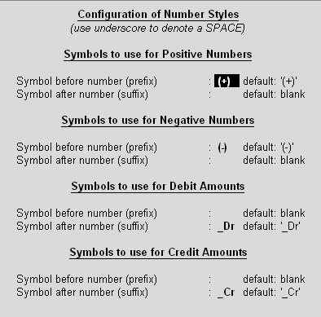
Understanding F12: Configurations (Contd.)
  The following figure shows the Number Styles configuration screen.
Notes:
Share the session objectives with the students.

Slide 30
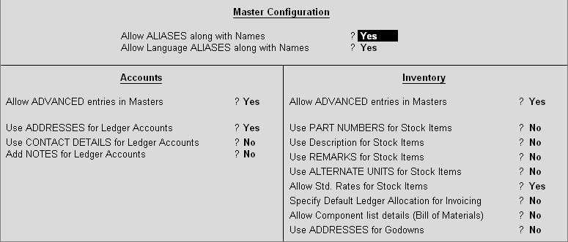
Understanding F12: Configurations (Contd.)
Accts/Inventory Info.:
  It allows to configure the accounting and inventory information.
  The following figure shows the Accts/Inventory Info. menu.
Notes:
Share the session objectives with the students.

Slide 31
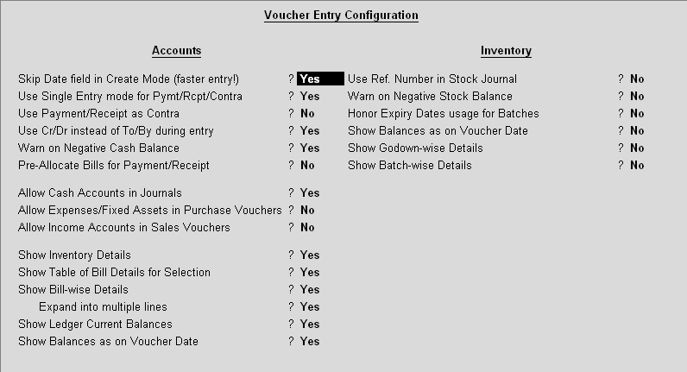
Understanding F12: Configurations (Contd.)
Voucher Entry:
  The Voucher Entry menu allows you to configure the accounting and inventory vouchers for additional information.
  The following figure shows the Voucher Entry menu.
Notes:
Share the session objectives with the students.

Slide 32
Understanding F12: Configurations (Contd.)
Invoice or Orders entry:
  It allows you to configure additional information such as Export details and Shipping details.
Printing:
  It helps the user to configure the printing screens for the reports and transactions.
Data Configuration:
  It helps the user to define location of Language Files, Tally Configuration File, Export Files, Data Files and details of the companies to be loaded on startup.
Notes:
Share the session objectives with the students.

Slide 33
Understanding F12: Configurations (Contd.)
TDL Configuration:
  It allows you to provide following details regarding TDL Configuration for the product:
    Local TDLs
    Account TDLs
    Remote TDLs
Advanced Configuration:
  It helps the user to specify the following details for ODBC connectivity and synchronisation of data:
    Client/Server configuration
    Connection configuration
    Proxy configuration
Notes:
Share the session objectives with the students.

Slide 34
Understanding F12: Configurations (Contd.)
Licensing:
  It the user to update, surrender, reset license and configure the existing License.
Notes:
Share the session objectives with the students.

Slide 35
Setting up Account Heads
Tally.ERP 9 allows you to create account heads and groups as per user requirements.
Chart of Accounts:
  Tally.ERP 9:
    Follows the Double Entry system of Accounting.
    Records accounting information by debiting and crediting different Ledger Accounts using different voucher types depending upon the nature of transaction.
    Automatically collates the debit and credit amounts and arrives at the closing balance of each ledger/group/report.
Pre-defined Groups of Accounts:
  There are 28 predefined groups in Tally.ERP 9 used in the Chart of Accounts for many trading organisations.
  Out of these, 15 groups are Primary Groups and the remaining 13 are Sub-Groups.
Notes:
Share the session objectives with the students.

Slide 36
Setting up Account Heads (Contd.)
Groups and Ledgers:
  Group is a collection of Ledgers of the same nature.
  Ledger account heads are the actual account heads with which we identify the transactions.
  All voucher entries have to be passed using ledgers.
Notes:
Share the session objectives with the students.

Slide 37
Setting up Account Heads (Contd.)
How can we create ledgers?
Notes:
Share the session objectives with the students.

Slide 38
Setting up Account Heads (Contd.)
To create ledgers, you need to perform the following tasks:
Go to the Gateway of Tally> Accounts Info.>Ledgers>Create
Notes:
Share the session objectives with the students.

Slide 39
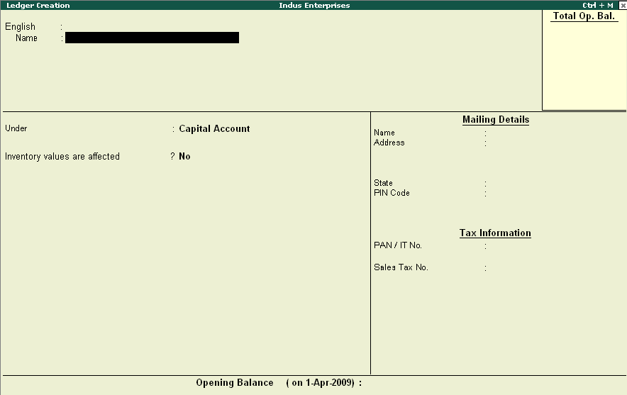
Setting up Account Heads (Contd.)
  The following figure shows the Ledger Creation screen.
Notes:
Share the session objectives with the students.

Slide 40
Setting up Account Heads (Contd.)
How can we create groups?
Notes:
Share the session objectives with the students.

Slide 41
Setting up Account Heads (Contd.)
To create groups, you need to perform the following tasks:
Go to the Gateway of Tally > Accounts Info. > Groups
Notes:
Share the session objectives with the students.

Slide 42
Setting up Account Heads (Contd.)
Let us see how to create
Stock Group.
Notes:
4.1.1 Creating Stock Group

Slide 43
Setting up Account Heads (Contd.)
Let us see how to create
Multiple Groups.
Notes:
Share the session objectives with the students.

Slide 44
Summary
In this session, you learnt that:
  F11: Features are company-specific. You are allowed to specify options that are specific to the selected company only.
  The Accounting Features helps the user to create Budgets and Scenarios, Currencies, Cost Centres, Cost Categories etc. in addition to Groups and Ledgers.
  The Inventory Features helps the user to create Stock categories, Multiple Godowns, Use Tracking Numbers, Order Processing, Price levels etc. in addition to Stock Groups, Stock Items and Units of Measure.

Slide 45
Summary (Contd.)
  The Statutory & Taxation Features helps the user to enable Value Added Tax (VAT), Excise, Service Tax, Tax deducted at Source(TDS), Tax Collected at Source (TCS), Excise Duty along with Tax information such as Local Sales Tax Number, Inter-state Sales Tax Number, PAN/Income - Tax Number.
  F12: Configuration options are applicable to all the companies in the same data directory.
  All financial entries are performed using ledgers or account heads.
  Group is a collection of Ledgers of the same nature.

